Slide 1
Chapter-3
CPU scheduling

Slide 2
Chapter Objectives:
To introduce CPU scheduling, which is the basis for multiprogrammed operating systems.
To discuss evaluation criteria for selecting a CPU-scheduling algorithm for a particular system.
To describe various CPU-scheduling algorithms.

Slide 3
Basic Concepts
In a single-processor system, only one process can run at a time; any others must wait until the CPU is free and can be rescheduled.
The objective of multiprogramming is to have some process running at all times, to maximize CPU utilization.
Scheduling is a fundamental operating-system function. Almost all computer resources are scheduled before use.
The CPU is, of course, one of the primary computer resources. Thus, its scheduling is central to operating-system design.

Slide 4
Process scheduling
Scheduling refers to the set of policies and mechanisms that an OS supports for determining the order of execution of the pending jobs and processes.
The process scheduling is the activity of the process manager that handles the removal of the running process from the CPU and the selection of another process on the basis of a particular strategy.
A scheduler is an OS program that selects the next job to be admitted for execution.

Slide 5
Cont…
NOTE: The main objective of scheduling is to increase CPU utilization and to increase the throughput.
Throughput: means the amount of work accomplished in a given time interval

Slide 6
CPU Scheduler
Selects from among the processes in memory that are ready to execute and allocates the CPU to one of them.
The aim of CPU scheduling is to make the system efficient, fast, and fair.
CPU scheduling decisions may take place when a process:
Switches from running to waiting state (ex., I/O request).
Switches from running to ready state (ex., Interrupts occur).
Switches from waiting to ready (ex., Completion of I/O).
Terminates.
Note:- Scheduling under 1 and 4 is non-preemptive(till it terminates or switches to waiting state); otherwise is called preemptive (limited time).

Slide 7
Preemptive Scheduling:
Preemptive scheduling is used when a process switches from running state to ready state or from waiting state to ready state.
The resources (mainly CPU cycles) are allocated to the process for the limited amount of time and then is taken away, and the process is again placed back in the ready queue if that process still has CPU burst time remaining.
That process stays in ready queue till it gets next chance to execute.
Algorithms based on preemptive scheduling are: Round Robin (RR),Shortest Remaining Time First (SRTF), Priority (preemptive version), etc.

Slide 8
Non-Preemptive Scheduling:
Non-preemptive Scheduling is used when a process terminates, or a process switches from running to waiting state.
In this scheduling, once the resources (CPU cycles) is allocated to a process, the process holds the CPU till it gets terminated or it reaches a waiting state.
In case of non-preemptive scheduling process does not interrupt in the middle of execution.
Instead, it waits till the process complete its CPU burst time and then it can allocate the CPU to another process.
Algorithms based on non-preemptive scheduling are: Shortest Job First (SJF basically non preemptive) and Priority (non preemptive version), etc.

Slide 9
Process Scheduling Queues revision
Job queue − This queue keeps all the processes in the system.
Ready queue − This queue keeps a set of all processes residing in main memory, ready and waiting to execute. A new process is always put in this queue.
Device queues − The processes which are blocked due to unavailability of an I/O device constitute this queue.

Slide 10
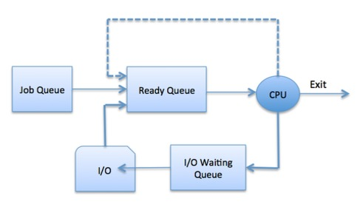
Cont…

Slide 11
Types of scheduler
Schedulers are special system software which handle process scheduling in various ways.
Their main task is to select the jobs to be submitted into the system and to decide which process to run. Schedulers are of three types −
Long term scheduler
Medium term scheduler
Short term scheduler

Slide 12
Long-Term scheduler
Due to the smaller size of main memory initially all program are stored in secondary memory.
When they are stored or loaded in the main memory they are called process.
This is the decision of long term scheduler that how many processes will stay in the ready queue.
Hence, in simple words, long term scheduler decides the degree of multi-programming of system.

Slide 13
Cont…
It also known as a job scheduler
“ Long-term ” scheduler b/c the time for which the scheduling is valid is long.
When the processor utilization is low then the scheduler admits more jobs to increase the number of processes in the ready queue.

Slide 14
Con’t…
Similarly when the utilization factor is very high then the long-term scheduler may reduce the rate of batch jobs.
Long-term scheduler is invoked very infrequently (seconds, minutes) ⇒ (may be slow).
Selects which processes should be brought into the ready queue.

Slide 15
Medium Term Scheduler
Most often, a running process needs I/O operation which doesn’t requires CPU.
Hence during the execution of a process when an I/O operation is required then the operating system sends that process from running queue to blocked queue.
When a process completes its I/O operation then it should again be shifted to ready queue.
Or in other word, a running process may become suspended if it makes an I/O request.
In this condition, to remove the process from memory and make space for other processes, the suspended process is moved to the secondary storage.
All these decisions are taken by the medium-term scheduler. Medium-term scheduling is a part of swapping. Or This process is called swapping

Slide 16
Short-Term scheduler
Short-Term scheduler(CPU scheduler) selects a process among the processes that are ready to execute and allocates CPU to one of them.
It is the change of ready state to running state of the process.
Its main objective is to maximize CPU utilization and to increase system performance in accordance with the chosen set of criteria.
Short-term scheduler is invoked very frequently (milliseconds) ⇒ (must be fast).
Selects which process should be executed next and allocates CPU.

Slide 17
Cont…
NOTE: Short-term scheduler executes at least once every 10 milliseconds.
Short-term schedulers, also known as dispatchers, make the decision of which process to execute next.

Slide 18
Dispatcher
A dispatcher is a special program which comes into play after the scheduler.
When the scheduler completes its job of selecting a process, it is the dispatcher which takes that process to the desired state/queue.
The dispatcher is the module that gives a process control over the CPU after it has been selected by the short-term scheduler.

Slide 19
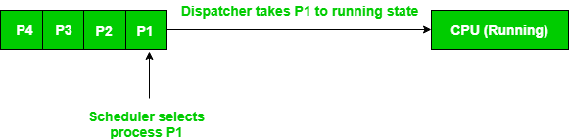
Difference between dispatcher and scheduler

Slide 20
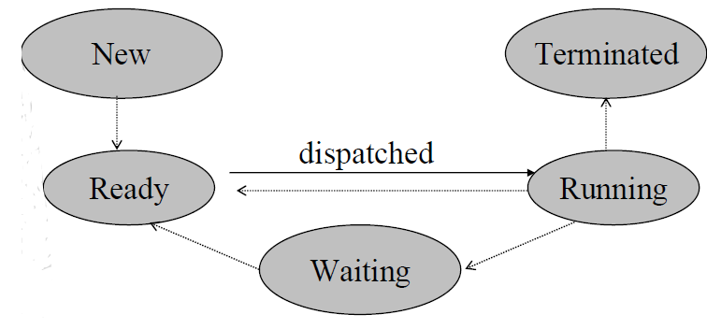
Con’t…

Slide 21
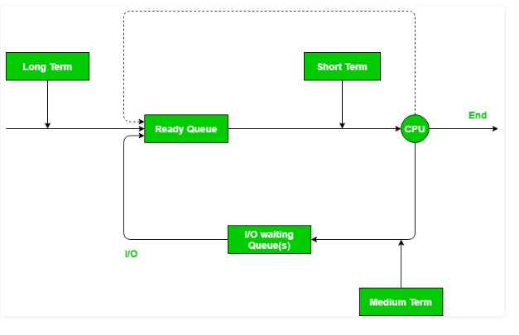
Schedulers with diagram

Slide 22
Comparison among Scheduler
S.N. | Long-Term Scheduler | Short-Term Scheduler | Medium-Term Scheduler
1 | It is a job scheduler | It is a CPU scheduler | It is a process swapping scheduler.
2 | Speed is lesser than short term scheduler | Speed is fastest among other two | Speed is in between both short and long term scheduler.
3 | It controls the degree of multiprogramming | It provides lesser control over degree of multiprogramming | It reduces the degree of multiprogramming.
4 | It is almost absent or minimal in time sharing system | It is also minimal in time sharing system | It is a part of Time sharing systems.
5 | It selects processes from pool and loads them into memory for execution | It selects those processes which are ready to execute | It can re-introduce the process into memory and execution can be continued.

Slide 23
Scheduling criteria's
Burst time
Every process in a computer system requires some amount of time for its execution. This time is both the CPU time and the I/O time.
In general, we ignore the I/O time and we consider only the CPU time for a process. So, Burst time is the total time taken by the process for its execution on the CPU.

Slide 24
Arrival time
Arrival time is the time when a process enters into the ready state and is ready for its execution.
Exit time
Exit time is the time when a process completes its execution and exit from the system.

Slide 25
Response time
Response time is the time spent when the process is in the ready state and gets the CPU for the first time.
Response time = Time at which the process gets the CPU for the first time - Arrival time
For example, here we are using the First Come First Served CPU scheduling algorithm for the below 3 processes:
process | Arrival time | Burst time
P1 | 0 ms | 8 ms
P2 | 1 ms | 7ms
P3 | 2 ms | 10ms

Slide 26
Cont…
Here, the response time of all the 3 processes are:
P1: 0 ms
P2: 7 ms because the process P2 have to wait for 8 ms during the execution of P1 and then after it will get the CPU for the first time. Also, the arrival time of P2 is 1 ms. So, the response time will be 8-1 = 7 ms.
P3: 13 ms because the process P3 have to wait for the execution of P1 and P2 i.e. after 8+7 = 15 ms, the CPU will be allocated to the process P3 for the first time. Also, the arrival of P3 is 2 ms. So, the response time for P3 will be 15-2 = 13 ms.

Slide 27
Waiting time
Waiting time is the total time spent by the process in the ready state waiting for CPU.
Waiting time = Turnaround time - Burst time
For example, consider the arrival time of all the below 3 processes to be 0 ms, 0 ms, and 2 ms and we are using the First Come First Serve scheduling algorithm.
Process | Arrival time | Burst time
P1 | 0 ms | 8ms
P2 | 0ms | 7ms
P3 | 2ms | 10ms
Gantt chart
P1 | P2 | P3
0 ms 8 ms | 8 ms 15 ms | 15 ms 25 ms

Slide 28
Cont…
Then the waiting time for all the 3 processes will be:
P1: 0 ms
P2: 8 ms because P2 have to wait for the complete execution of P1 and arrival time of P2 is 0 ms.
P3: 13 ms becuase P3 will be executed after P1 and P2 i.e. after 8+7 = 15 ms and the arrival time of P3 is 2 ms. So, the waiting time of P3 will be: 15-2 = 13 ms.

Slide 29
What is the difference between waiting time and response time?
Response time is the time spent between the ready state and getting the CPU for the first time.
But the waiting time is the total time taken by the process in the ready state.
Let's take an example of a round-robin scheduling algorithm. The time quantum is 2 ms.

Slide 30
Cont…
Process | Arrival time | Burst time
P1 | 0 ms | 4 ms
P2 | 0 ms | 6 ms
Time quantum= 2 ms
The response time of the process P2 is 2 ms because after 2 ms, the CPU is allocated to P2 and the waiting time of the process P2 is 4 ms i.e turnaround time - burst time (10 - 6 = 4 ms).
Gantt chart
P1 | P2 | P1 | P2 | p2
0 2 | 2 4 | 4 6 | 8 | 8 10

Slide 31
Turnaround time
Turnaround time is the total amount of time spent by the process from coming in the ready state for the first time to its completion.
Turnaround time = Burst time + Waiting time
or
Turnaround time = Exit time - Arrival time
For example, if we take the First Come First Serve scheduling algorithm, and the order of arrival of processes is P1, P2, P3 and each process is taking 2, 5, 10 seconds.
Then the turnaround time of P1 is 2 seconds , P2 is 7 seconds ,and P3 will be 17 seconds
Note: Different CPU scheduling algorithms produce different turnaround time for the same set of processes. This is because the waiting time of processes differ when we change the CPU scheduling algorithm.

Slide 32
Throughput
Throughput is a way to find the efficiency of a CPU.
It can be defined as the number of processes executed by the CPU in a given amount of time.
For example, let's say, the process P1 takes 3 seconds for execution, P2 takes 5 seconds, and P3 takes 10 seconds. So, in this case, the throughput will be (3+5+10)/3 = 18/3 = 6 seconds.
CPU utilization
Keep the CPU as busy as possible

Slide 33
Optimization Criteria
Max CPU utilization
Max throughput
Min turnaround time
Min waiting time
Min response time

Slide 34
Categories of Scheduling Algorithms
Not surprisingly, in different environments different scheduling algorithms are needed. This situation arises because different application areas (and different kinds of operating systems) have different goals.
In other words, what the scheduler should optimize for is not the same in all systems. Three environments worth distinguishing are:
Batch
Interactive and
Real time
Reading assignment
Which of the following scheduling algorithms are belonging to each environment? Why?

Slide 35
Scheduling Algorithms
A Process Scheduler schedules different processes to be assigned to the CPU based on particular scheduling algorithms.
There are six popular process scheduling algorithms:
First-Come First-Served (FCFS)
Shortest-Job-First (SJF)
Priority
Round-Robin (RR)
Multilevel Queue and
Multilevel Feedback Queue

Slide 36
Cont…
These algorithms are either non-preemptive or preemptive.
Non-preemptive algorithms are designed so that once a process enters the running state, it cannot be preempted until it completes its allotted time,
whereas the preemptive scheduling is based on priority where a scheduler may preempt a low priority running process anytime when a high priority process enters into a ready state.

Slide 37
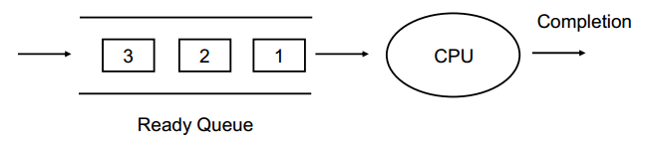
1. First-Come First-Served (FCFS) Scheduling
It is the simplest CPU scheduling algorithm.
The process that requests the CPU first is allocated the CPU first.
The average waiting time under FCFS is long.

Slide 38
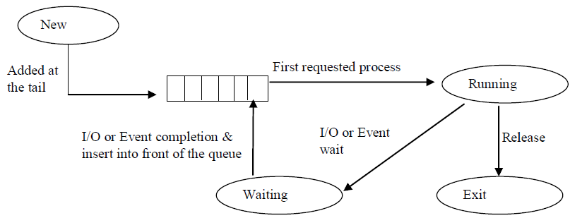
Figure below shows First Come First Serve Scheduling

Slide 39
Example:1
Process Burst Time (In milliseconds)
P₁ 24
P₂ 3
P₃ 3
Suppose that the processes arrive in the order: P₁ , P₂ and P₃
The Gantt Chart for the schedule is:
Waiting time for P₁ = 0, P₂ = 24 and P₃ = 27
Average waiting time: (0 + 24 + 27)/3 = 17 ms
Average Turnaround Time (ATAT) = 24+27+30/3= 27 ms
P₁
P₂
P₃
0
24
27
30

Slide 40
Example 2
Suppose that the processes arrive in the order: P₂ , P₃ and P₁
Waiting time for: P₁, P_{2,} and , P₃ ?
Average waiting time?
Average Turnaround Time (ATAT)?
P₂
P₃
P₁
0
3
6
30

Slide 41
Waiting time for: P₁ = 6, P₂ = 0, P₃ = 3
Average waiting time: (0 + 3 + 6)/3 = 3 ms
Average Turnaround Time (ATAT)= 3+6+30/3=13 ms
Much better than previous case.
The order of processes in FCFS queue is important.

Slide 42
Exercise 1
Consider the following processes: P1,P2 and P3 with their CPU burst time as shown below
Base on the above table
Draw the Gantt chart
Waiting time for each process (WT)
Average Waiting time (AWT)
Average Turnaround Time (ATAT)
Process | CPU burst time (ms)
P1 | 7
P2 | 8
P3 | 5

Slide 43
Advantages and Disadvantages of FCFS
Advantage
Simple and easy algorithm to implement
It is suitable for batch system
Disadvantage
The average waiting time is not minimal
It is not suitable for time sharing system

Slide 44
2. Shortest-Job-First (SJF) Scheduling
Also known as shortest job next.
The basic principle of this algorithm is to allocate the CPU to the process with least CPU burst time.
Associate each process with the length of its next CPU burst.
Use these lengths to schedule the process with the shortest time.
Best approach to minimize waiting time.
Easy to implement in Batch systems where required CPU time is known in advance.
Impossible to implement in interactive systems where required CPU time is not known.
The processer should know in advance how much time process will take.

Slide 45
Con’t…
Two schemes:
Non-preemptive: Once CPU given to the process it can not be preempted until completes its CPU burst.
Preemptive: if a new process arrives with CPU burst length less than remaining time of current executing process, preempt.
This scheme is know as the Shortest-Remaining-Time-First (SRTF).
SJF is optimal: gives minimum average waiting time for a given set of processes.
Note: If the two processes have same CPU burst time the FCFS is used to break the tie.

Slide 46
Example of Non-Preemptive SJF
Process Id Arrival Time Burst Time
P1 0 7
P2 2 4
P3 4 1
P4 5 4
1. Draw Gantt chart for the above process?
2. Waiting time for each process?
3. Average waiting time?

Slide 47
Solution
Gantt chart
2. Waiting time for each process
Waiting time= total waiting time-arrival time
waiting time: P1=0, P2=6, P3=3 and P4=7
3. Average waiting time = (0+ 6 + 3 + 7) / 4 = 4
P₁
P₃
P₂
P₄
0
7
8
12
16

Slide 48
Con’t…
If we used FCFS, then the average waiting time would be:
(0 + 5 + 7 + 7) / 4 = 4.75
The SJF gives less average waiting time than FCFS.
The SJF is a nonpreemptive in which the waiting process with the smallest estimated run-time-to completion is run next.
Both FCFS and SJF are not useful for timesharing environments, because they are nonpreemptive.

Slide 49
Example1 of Preemptive SJF
SJF (preemptive) [Shortest-Remaining-Time-First (SRTF)]
Process ID Arrival Time Burst Time
P1 0 7
P2 2 4
P3 4 1
P4 5 4
waiting time for each process?
Average waiting time?
P₁
P₂
P₃
P₂
P₄
P₁
0
2
4
5
7
11
16

Slide 50
Solution
Waiting time for each process= total waiting time-number of millisecond process executed-arrival time
P1= 11-2-0=9ms
P2= 5- 2-2=1ms
P3= 4-0-4= 0ms
P4= 7-0-5= 2ms
Average waiting time = (9 + 1 + 0 +2) / 4 = 3 ms

Slide 51
Example2 of Preemptive SJF
Gantt chart?
Waiting time?
Average waiting time?
Process Id | Arrival time | Burst time
P1 | 0 | 12
P2 | 2 | 4
P3 | 3 | 6
P4 | 8 | 5

Slide 52
Solution
1. Gantt chart of the above process
2. Waiting time for each process
P1=17-2-0=15
p2=2-0-2=0
P3=6-0-3=3
P4=12-0-8=4
3. Average waiting time =(15+0+3+4)/4= 5.5 ms
P1 | P2 | P3 | P4 | P1
0 | 2 | 6 | 12 | 17 27

Slide 53
Exercise 2
Consider the following set of processes having their CPU-burst time and arrival time. Based on these find the average waiting time using
Non- preemptive SJF?
Preemptive SJF?
Process Arrival Time Burst Time
P1 0 3
P2 2 6
P3 4 4
P4 6 5
P5 8 2

Slide 54
3. Priority Scheduling
A priority number (integer) is associated with each process, and the CPU is allocated to the process with the highest priority.
Priority may be determined by users or by some default mechanism.
The system may determine the priority based on memory requirements, time limits, or other resource usage.
The CPU is allocated to the process with the highest priority
(smallest integer = highest priority).
Equal priority processes are scheduled in FCFS order.

Slide 55
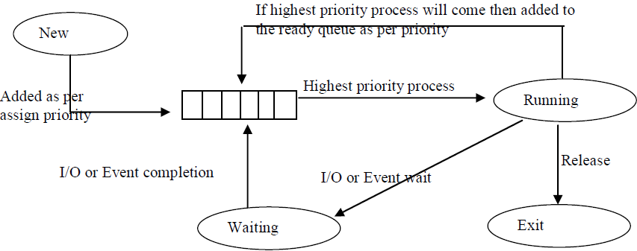
Con’t…
Figure above shows: Priority Scheduling

Slide 56
Con’t…
Priorities can be defined either internally or externally.
Internally priority:- use of some measurable quantity or quantities to compute the priority of a process.
For example, memory requirements, number of open files, ratio of average I/O burst to average CPU burst have been used in computing priorities.
Externally priority:- is set by criteria that is external to the O.S.; such as importance of the process.

Slide 57
Con’t…
SJF is a special case of general priority scheduling, where as priority is the predicted next CPU burst time.
Priority can be either preemptive or nonpreemptive.
A preemptive: priority will preempt the CPU if the newly arrived process is higher than the priority of the currently running process.
A nonpreemptive: priority will simply put the new highest priority process at the head of the ready queue.

Slide 58
Problem with priority scheduling
A major problem with priority scheduling is indefinite blocking or Starvation (waiting for the CPU but never gets the CPU)
A process that is ready to run but waiting for the CPU can be considered blocked.
A priority scheduling algorithm can leave some low priority processes waiting indefinitely.
In a heavily loaded computer system, a steady stream of higher-priority processes can prevent a low- priority process from ever getting the CPU.

Slide 59
Solution to the problem
A solution to the problem of indefinite blockage of low-priority processes is aging. Aging is a technique of gradually increasing the priority of processes that wait in the system for a long time.
For example:
If priorities range from 1279low) to 0 (high), we could increase the priority of a waiting process by 1 every 15 minutes.
Eventually, even a process with an initial priority of 127 would have the highest priority in the system and would be executed.

Slide 60
Example (preemptive base)
Consider a set of three processes P1,P2 and P3 with their priorities and arrival times
Process Burst time Priority Arrival time
P1 10 3 0
P2 5 2 1
P3 2 1 2
1= highest priority, 3= least priority
AWT = (8-1)+(4-2)+0/3
= 7+2+0/3=9/3=3 ms
P₁
P₂
P₃
P₂
P₁
0
1
2
4
8
17

Slide 61
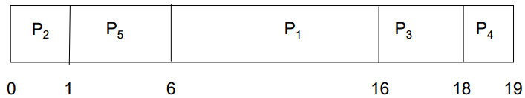
Exercise (Non-preemptive)
Process Burst Time Priority
P1 10 3
P2 1 1
P3 2 4
P4 1 5
P5 5 2
Priority scheduling Gantt Chart
Average waiting time?

Slide 62
Solution
Waiting time= total waiting time-number of processes execution in milliseconds-arrival time
Waiting time P1=6, P2=0,P3=16,P4=18 and P5=1
Therefore:
Average waiting time = 8.2 ms

Slide 63
Exercise 2:
Consider the set of process with arrival time(in milliseconds), CPU burst time (in milliseconds) and priority( 0 is the highest priority) shown below. None of the processes have I/O burst time.
The average waiting time(in milliseconds)of all the processes using preemptive priority scheduling algorithm is _____?
Process Id | Arrival time | Burst time | Priority
P1 | 0 | 11 | 2
P2 | 5 | 28 | 0
P3 | 12 | 2 | 3
P4 | 2 | 10 | 1
P5 | 9 | 16 | 4

Slide 64
Solution
Gantt chart
Priority for each process:
Waiting time= total waiting time-number of processes execution in milliseconds-arrival time
P1= 40-2-0=38
P2= 5-0-5= 0
P3= 49-0-12= 37
P4= 33-3-2= 28
P5= 51-0-9= 42
Average WT= (38+0+37+28+42)/5= 29
P1 | P4 | P2 | P4 | P1 | P3 | p5
0 2 | 5 | 33 | 40 | 49 | 51 | 67

Slide 65
4. Round Robin (RR) Scheduling
The Round Robin is designed for time sharing systems.
The RR is similar to FCFS, but preemption is added to switch between processes.
Each process gets a small unit of CPU time (time quantum or time slice ) usually 10-100 milliseconds.
After this time has elapsed, the process is preempted and added to the end of the ready queue.
That is, after the time slice is expired an interrupt will occur and a context switch.

Slide 66
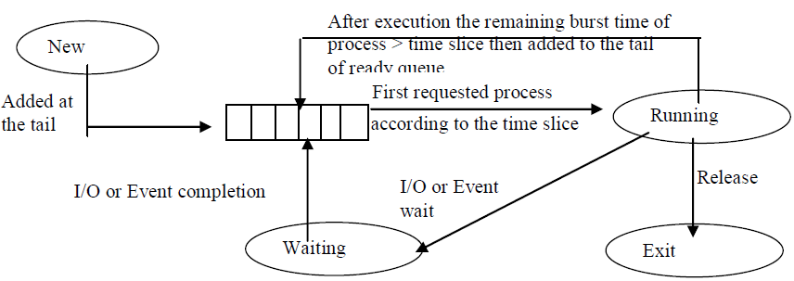
Con’t…
Figure above shows: Round Robin Scheduling

Slide 67
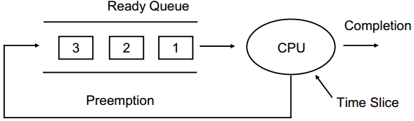
Con’t…
If there are n processes in the ready queue and the time quantum is q, then each process gets 1/n of the CPU time in chunks of at most q time units at once.
No process waits more than (n-1)q time units.

Slide 68
Con’t…
The performance of RR depends on the size of the time slice q:
If q very large (infinite) ⇒FCFS
If q very small ⇒RR is called processor sharing, and context switch increases.
So, q must be large with respect to context switch, otherwise overhead is too high.

Slide 69

Example 1: RR with Time Quantum = 20
Process Burst Time Waiting Time of each Process
P1 53 0+(77-20)+(121-97)=81
P2 17 20
P3 68 37+(97-57)+(134-117)=94
P4 24 57+(117-77)=97
The Gantt chart is:
Average Waiting Time = (81+20+94+97) / 4 = 73 ms

Slide 70
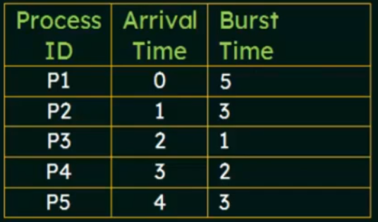
Exercise 2:
Consider the set of 5 processes whose arrival time and burst time are given below:
If the CPU scheduling policy is round robin with the time quantum= 2 units, calculate the average waiting time and average turnaround time.

Slide 71
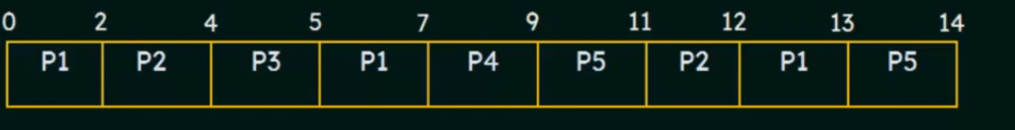
Solution
Gantt chart:
Ready queue |  |  |  | Time (clock)
 |  |  | p2 | 1
 |  | P1 | P3 | 2
 | P4 | P1 | P3 | 3
P2 | P5 | P4 | P1 | 4
 | P2 | P5 | P4 | 5
 | P1 | P2 | P5 | 7
 |  | … | … | ….
 |  | P5 | P1 | 12
 |  | … | … | …

Slide 72
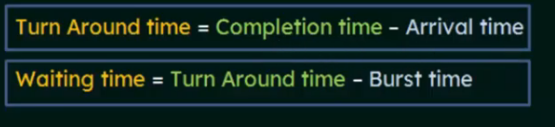
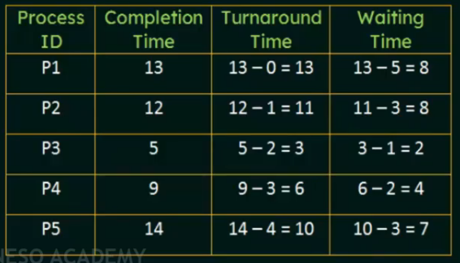
Solution Cont…

Slide 73
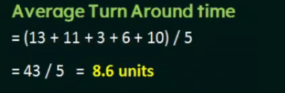
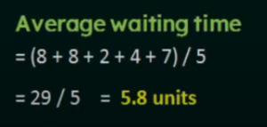
Solution Cont…

Slide 74
5. Multi level Queue Scheduling
Ready queue is partitioned into separate queues:
– Foreground (interactive)
– Background (batch)
Each queue has its own scheduling algorithm:
– Foreground – RR
– Background – FCFS

Slide 75
Con’t…
Scheduling must be done between the queues.
– Fixed priority scheduling; i.e., serve all from foreground then from background.
Possibility of starvation.
Time slice – each queue gets a certain amount of CPU time which it can schedule amongst its processes:
80% to foreground in RR
20% to background in FCFS

Slide 76
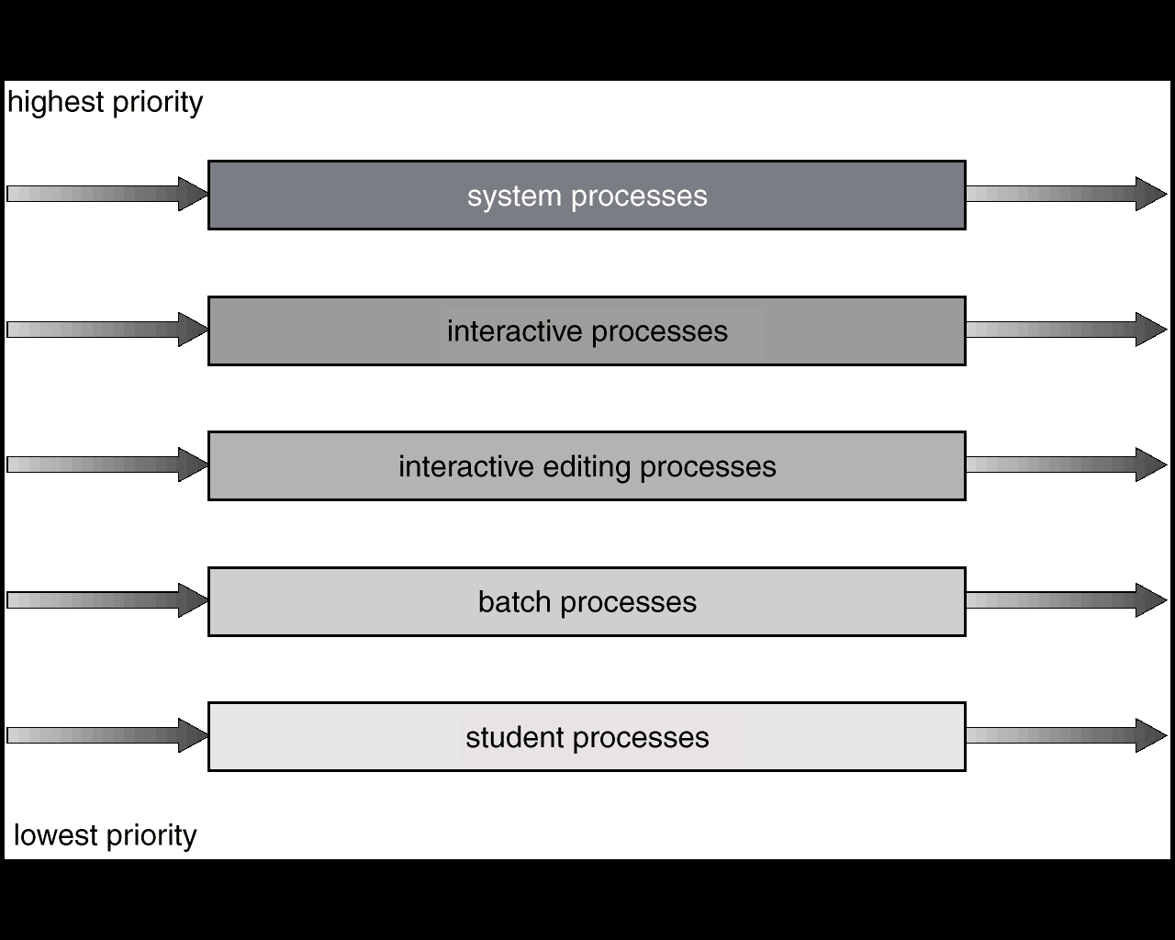
Multilevel Queue Scheduling

Slide 77
6. Multilevel Feedback Queue
Different from Multilevel Queue Scheduling by Allowing Processes to Migrate among queues.
A process can move between various queues, aging can be implemented this way.
If a process waits too long in a lower-priority queue may be moved to a higher-priority queue (this form of aging to prevent starvation).

Slide 78
Con’t…
If a process uses too much CPU time, it will be moved to lower-priority queues.
This leaves I/O bound and interactive processes in the higher-priority queues.
In general, the multilevel feedback queue scheduling algorithm is the most complex.

Slide 79
Example: Multilevel Feedback Queue
Three queues:
Q0 – Time quantum 8 milliseconds
Q1 – Time quantum 16 milliseconds
Q2 – FCFS
Scheduling:
– A new job enters queue Q0 which is served FCFS. When it gains CPU, job receives 8 milliseconds. If it does not finish in 8 milliseconds, job is moved to queue Q1
At Q1 job is again served FCFS and receives 16 additional milliseconds.
If it still does not complete, it is preempted and moved to queue Q2.
The Multilevel Feedback Queue Scheduling is preemptive.

Slide 80
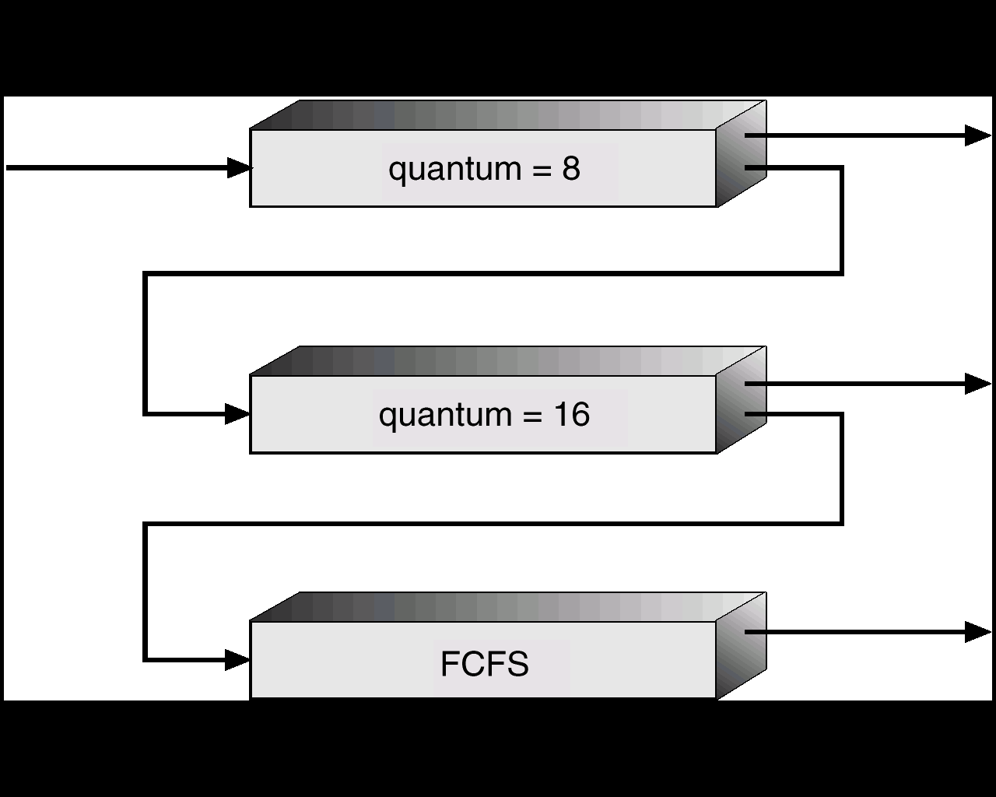
Multilevel Feedback Queues

Slide 81
Thank you !!!

